Slide 1
Body Fat Estimation:
Linear Regression
RUIZHEN JING, YANRUN LU, ANGELA WEI

Slide 2
Data Cleaning - Deletion
Individual (IDNO) | Original Observation | Deletion Reason
31 | ANKLE = 33.9 cm | Outlier ankle measure
39 | NECK = 51.2 cm | Outlier neck measure
42 | HEIGHT = 74.930 cm | Dwarfism not average
86 | ANKLE = 33.7 cm | Outlier ankle measure
172 | BODYFAT = 1.9% | Insufficient for life
182 | BODYFAT = 0% | Insufficient for life
Final Cleaned Data: 246 points, 8 predictors
Notes:
Our focus when it came to data cleaning was ensuring that our data was representative of the average. What this meant is that we had to delete measures that were outliers and others that were just unrealistic. This would help support any assumptions of normality in our data as well as ensure that any conclusions would be representative. We also had to deal with the colinearity of some of the factors by removing columns that were highly collinear until we were left with 8 predictors. [LOOK UP NAME OF TEST FOR COLLINEARITY]
Now that we had our data in place, we could then consider our options for models.

Slide 3
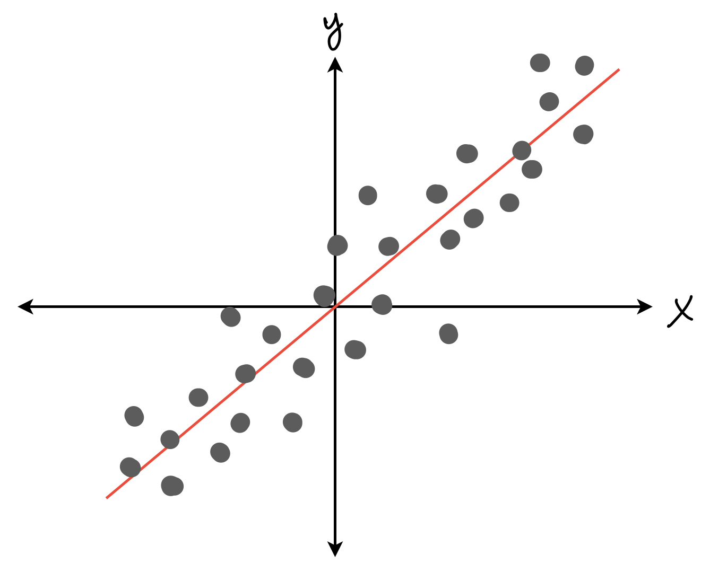
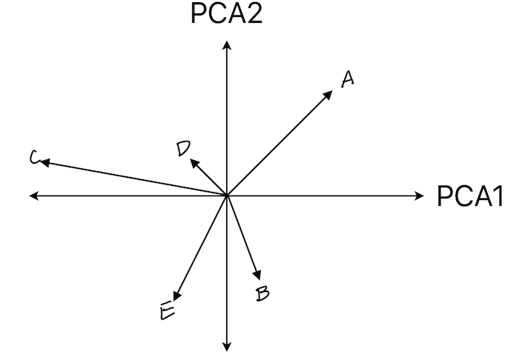
Model Options
Linear Regression
Principal Component Analysis (PCA)
Regression Tree
Notes:
To ensure that we chose the best prediction method, the team considered a few types of models including linear regression, principal component analysis, and a regression tree. But to be able to assess those individual models, we first had to come up with metrics for model performance.

Slide 4
Metric For Model Performance
How do we compare against the base linear model
(including all factors)?
Accuracy
R² = 0.75
Simplicity
# of Dependent Variables
Robustness
Train/ Test
Notes:
We decided to measure all models against the most computationally simple option we had, a linear model that included all non-collinear variables. This set our standard for accuracy, with an R² of 0.75, simplicity as 8 variables, and robustness as a comparison of accuracy for both training and test data. So now, let’s talk about how the models actually performed in these categories.

Slide 5
Model Performance
Model | Accuracy - R² For Training Data | Simplicity - # of Dependent Variables | Robustness - R² For Test Data
Linear Model (All Factors) | 0.75 | 8 | 0.68
PCA | [Conflicting PCA results. Unusable]
Decision Tree | 0.74 | 2 | 0.51
Linear Model (ABDOMEN & WRIST) | 0.73 | 2 | 0.67

Slide 6
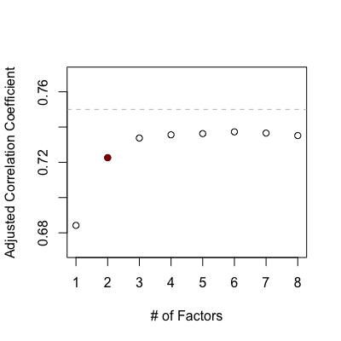
Why Two Factors?

Slide 7
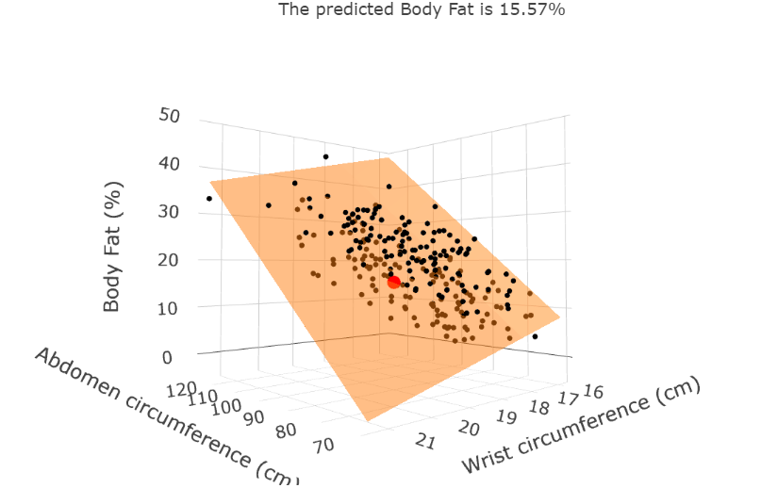
Linear Regression Model
[BODYFAT] = 0.7218*[ABDOMEN] - 2.079*[WRIST] - 9.8304
Example: Estimate of average body fat for U.S. men in 2021
 | Abdomen | Wrist | Body fat | 95% CI
Real value | 102 | 20 | 21.7%
Fitted value |  |  | 22.21% | 14.28%-30.14%

Slide 8
Diagnosis For Significance & Collinearity
 | F value | t value | p value
whole model | 304.5 | / | <0.01
Abdomen | / | 22.8 | <0.01
Wrist | / | -5.97 | <0.01
 | VIF value
Abdomen & Wrist | 1.54

Slide 9
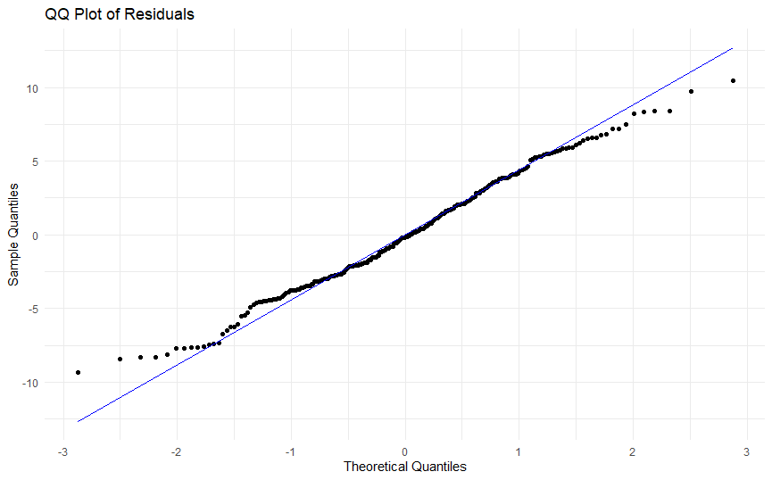
Diagnosis For Residual Normality

Slide 10
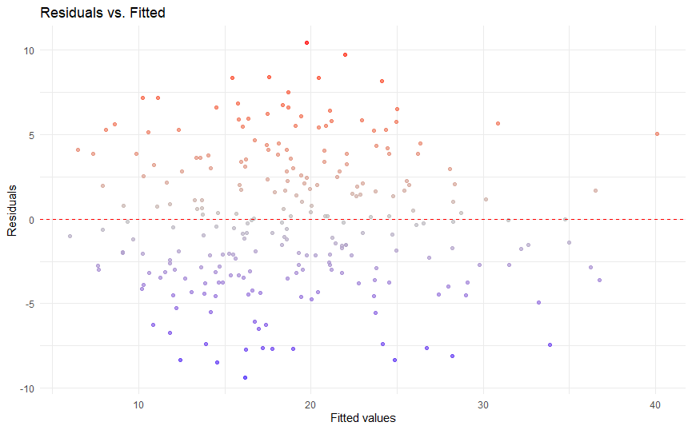
Diagnosis For Homoscedasticity

Slide 11
Model Strengths & Weaknesses
Strengths:
Simple dependence on variables
Easy to interpret the output coefficients
Consistent fit even with a small data set.
Weaknesses:
Limited accuracy with few variables.
Linear models require independence of variables.
Linear regression is sensitive to outliers
Had to cut out data: Removing the outlier with an ABDOMEN value of 148.1, the R-squared score of the model increased by about 2.

Slide 12
QUESTIONS?

